Slide 1

Pattern Classification
All materials in these slides were taken from
Pattern Classification (2nd ed) by R. O. Duda, P. E. Hart and D. G. Stork, John Wiley & Sons, 2000 with the permission of the authors and the publisher

Slide 2
Chapter 4 (Part 1):
Non-Parametric Classification (Sections 4.1-4.3)
Introduction
Density Estimation
Parzen Windows

Slide 3
Introduction
All Parametric densities are unimodal (have a single local maximum), whereas many practical problems involve multi-modal densities
Nonparametric procedures can be used with arbitrary distributions and without the assumption that the forms of the underlying densities are known
There are two types of nonparametric methods:
  Estimating P(x | w_{j} )
  Bypass probability and go directly to a-posteriori probability estimation
Pattern Classification, Ch4 (Part 1)

Slide 4
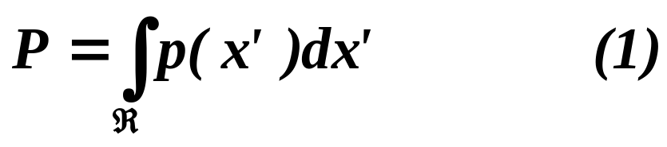
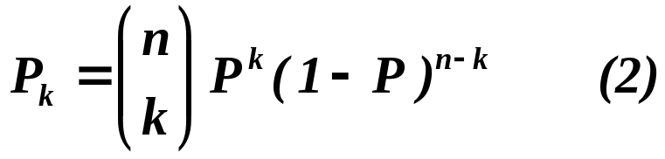
Density Estimation
  Basic idea:
  Probability that a vector x will fall in region R is:
  P is a smoothed (or averaged) version of the density function p(x) if we have a sample of size n; therefore, the probability that k points fall in R is then:
  and the expected value for k is:
  E(k) = nP (3)
Pattern Classification, Ch4 (Part 1)

Slide 5
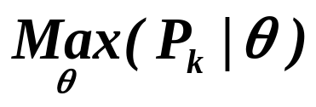
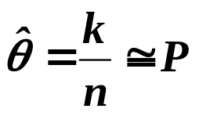
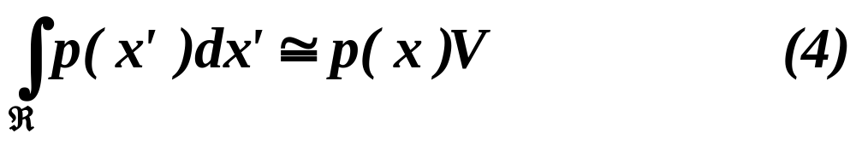
  ML estimation of P = θ
  is reached for
  Therefore, the ratio k/n is a good estimate for the probability P and hence for the density function p.
  p(x) is continuous and that the region R is so small that p does not vary significantly within it, we can write:
  where is a point within R and V the volume enclosed by R.
Pattern Classification, Ch4 (Part 1)

Slide 6
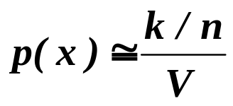
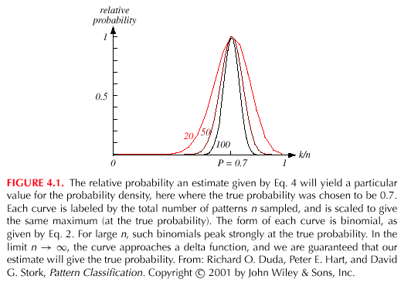
  Combining equation (1) , (3) and (4) yields:
Pattern Classification, Ch4 (Part 1)

Slide 7
Density Estimation (cont.)
Justification of equation (4)
  We assume that p(x) is continuous and that region R is so small that p does not vary significantly within R. Since p(x) = constant, it is not a part of the sum.
Pattern Classification, Ch4 (Part 1)

Slide 8
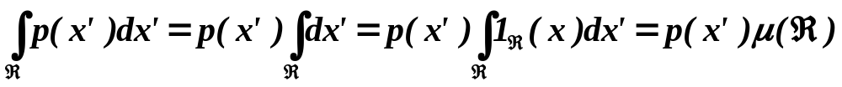
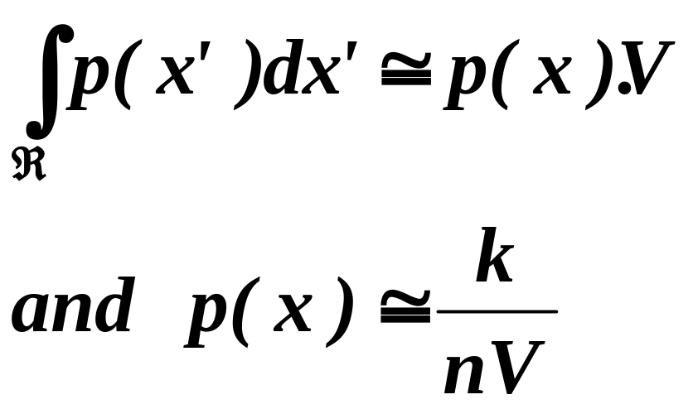
  Where: μ(R) is: a surface in the Euclidean space R²
  a volume in the Euclidean space R³
  a hypervolume in the Euclidean space R^{n}
  Since p(x) ≅ p(x’) = constant, therefore in the Euclidean space R³:
Pattern Classification, Ch4 (Part 1)

Slide 9
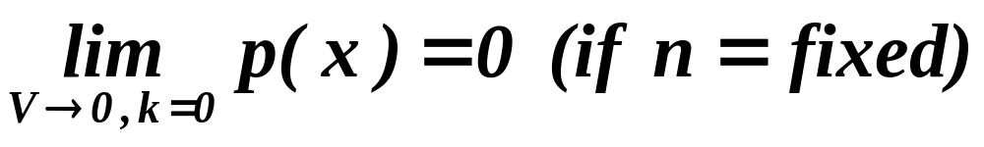
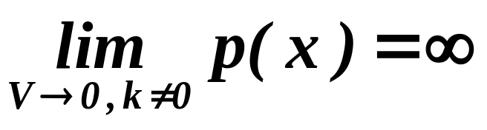
  Condition for convergence
    The fraction k/(nV) is a space averaged value of p(x).
    p(x) is obtained only if V approaches zero.
    This is the case where no samples are included in R: it is an uninteresting case!
    In this case, the estimate diverges: it is an uninteresting case!
Pattern Classification, Ch4 (Part 1)

Slide 10
The volume V needs to approach 0 anyway if we want to use this estimation
    Practically, V cannot be allowed to become small since the number of samples is always limited
    One will have to accept a certain amount of variance in the ratio k/n
    Theoretically, if an unlimited number of samples is available, we can circumvent this difficulty
    To estimate the density of x, we form a sequence of regions
    R₁, R₂,…containing x: the first region contains one sample, the second two samples and so on.
    Let V_{n} be the volume of R_{n}, k_{n} the number of samples falling in R_{n} and p_{n}(x) be the n^{th} estimate for p(x):
    p_{n}(x) = (k_{n}/n)/V_{n} (7)
Pattern Classification, Ch4 (Part 1)

Slide 11
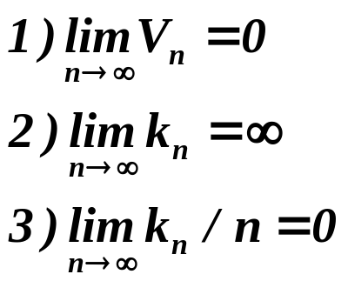
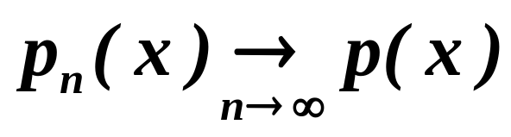
    Three necessary conditions should apply if we want p_{n}(x) to converge to p(x):
    There are two different ways of obtaining sequences of regions that satisfy these conditions:
    (a) Shrink an initial region where V_{n} = 1/√n and show that
    This is called “the Parzen-window estimation method”
    (b) Specify k_{n} as some function of n, such as k_{n} = √n; the volume V_{n} is
    grown until it encloses k_{n} neighbors of x. This is called “the k_{n}-nearest
    neighbor estimation method”
Pattern Classification, Ch4 (Part 1)

Slide 12
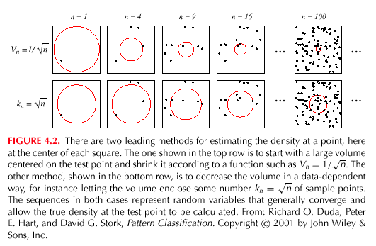
Pattern Classification, Ch4 (Part 1)

Slide 13
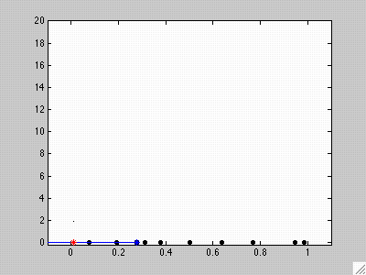

Slide 14
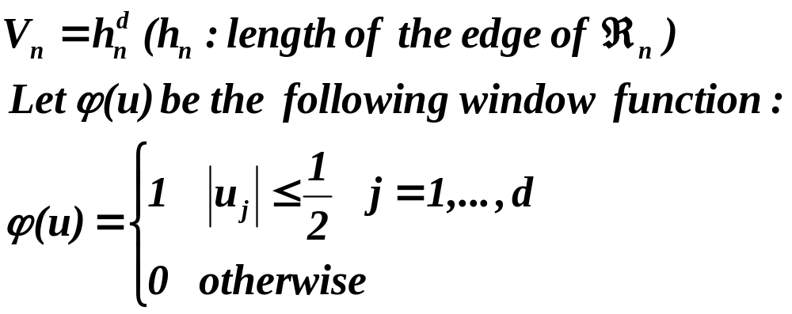
Parzen Windows
  Parzen-window approach to estimate densities assume that the region R_{n} is a d-dimensional hypercube
  ϕ((x-x_{i})/h_{n}) is equal to unity if x_{i} falls within the hypercube of volume V_{n} centered at x and equal to zero otherwise.
Pattern Classification, Ch4 (Part 1)

Slide 15
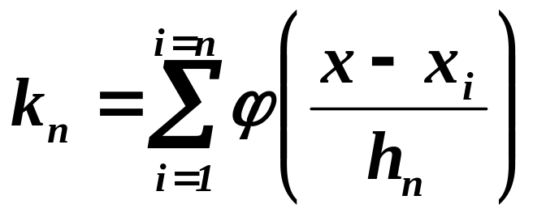
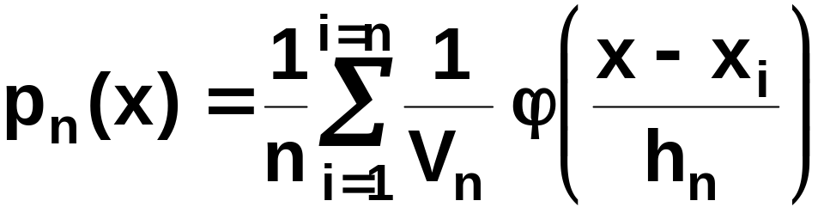
  The number of samples in this hypercube is:
  By substituting k_{n} in equation (7), we obtain the following estimate:
    P_{n}(x) estimates p(x) as an average of functions of x and
    the samples (x_{i}) (i = 1,… ,n). These functions ϕ can be general!
Pattern Classification, Ch4 (Part 1)

Slide 16
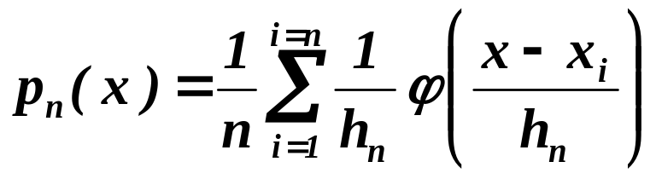
  Illustration
    The behavior of the Parzen-window method
      Case where p(x) →N(0,1)
    Let ϕ(u) = (1/√(2π) exp(-u²/2) and h_{n} = h₁/√n (n>1)
    (h₁: known parameter)
    Thus:
    is an average of normal densities centered at the
    samples x_{i}.
Pattern Classification, Ch4 (Part 1)

Slide 17
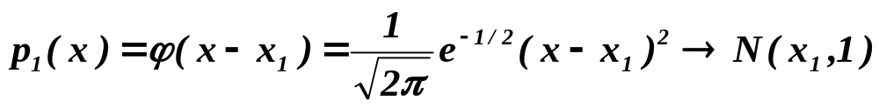
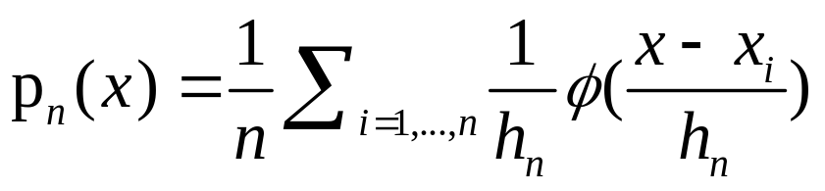
      Numerical results:
      For n = 1 and h₁=1
      For n = 10 and h = 0.1, the contributions of the individual samples are clearly observable !
Pattern Classification, Ch4 (Part 1)

Slide 18
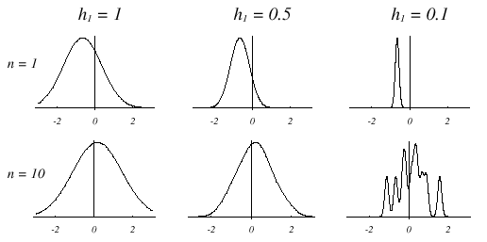
Pattern Classification, Ch4 (Part 1)

Slide 19
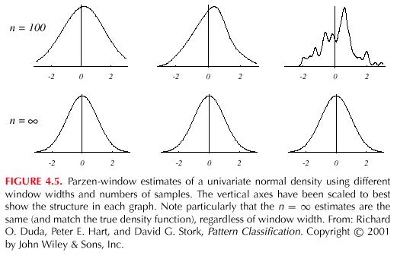
Pattern Classification, Ch4 (Part 1)

Slide 20
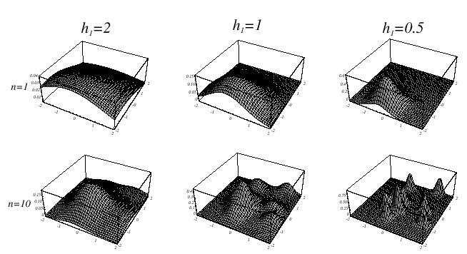
Analogous results are also obtained in two dimensions as illustrated:
Pattern Classification, Ch4 (Part 1)

Slide 21
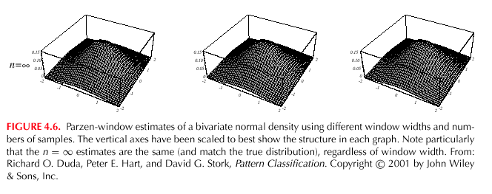
Pattern Classification, Ch4 (Part 1)

Slide 22
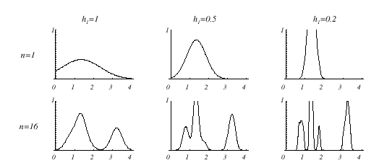
      Case where p(x) = λ₁.U(a,b) + λ₂.T(c,d) (unknown density) (mixture of a uniform and a triangle density)
Pattern Classification, Ch4 (Part 1)

Slide 23
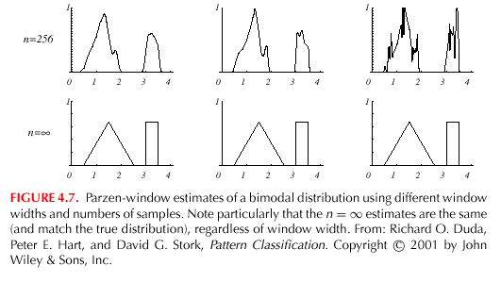
Pattern Classification, Ch4 (Part 1)

Slide 24
  Classification example
    In classifiers based on Parzen-window estimation:
    We estimate the densities for each category and classify a test point by the label corresponding to the maximum posterior
    The decision region for a Parzen-window classifier depends upon the choice of window function as illustrated in the following figure.
Pattern Classification, Ch4 (Part 1)

Slide 25
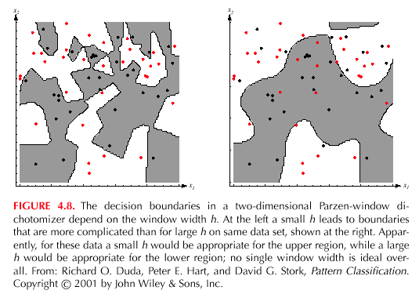
Pattern Classification, Ch4 (Part 1)

